Slide 1
CCLE Integrative Project
5/26/20

Slide 2
Data Summary
34 breast cancer cell lines
Positive or negative for ER-alpha/ESR1
Originally 47 cell lines, but after PCA to look at batch effect, some were filtered to make downstream analysis easier
RNA-seq
Normalization
RPKM
TPM
RPPA
Notes:
ER-alpha based on RPPA data

Slide 3
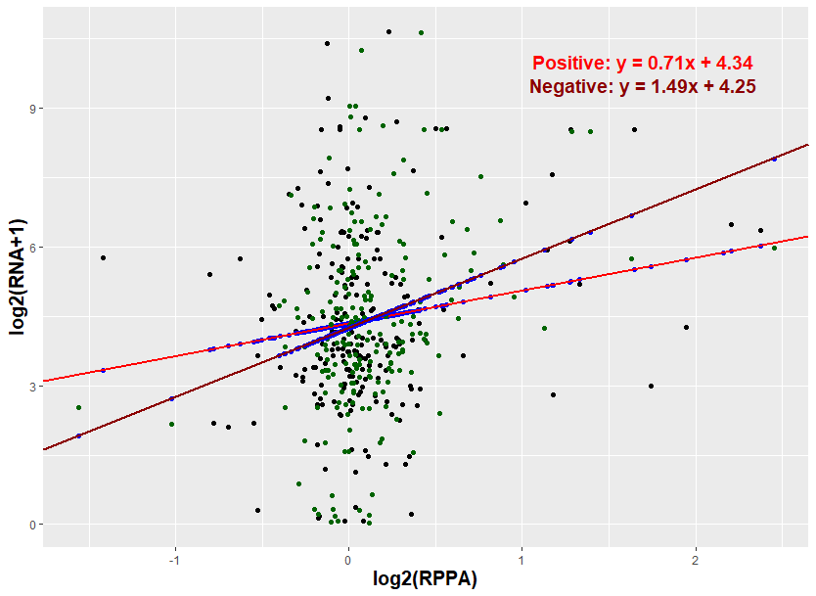
Data Processing: Transformation
Linear regression on gene expression averages
RPPA vs. RNA
RNA
Log2(average_RNA + 1)
RPPA
Log2(average_RPPA)
Notes:
Picture on RPKM
Black dots: untransformed positive sample values
Dark green dots: untransformed negative sample values
Blue dots: transformed positive/negative sample values
Red line: linear regression line for positive
Dark red line: linear regression line for negative

Slide 4
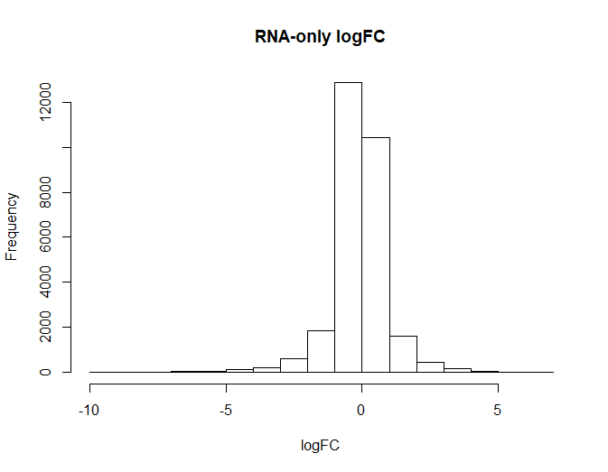
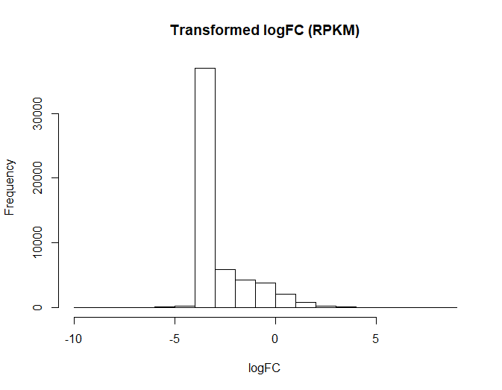
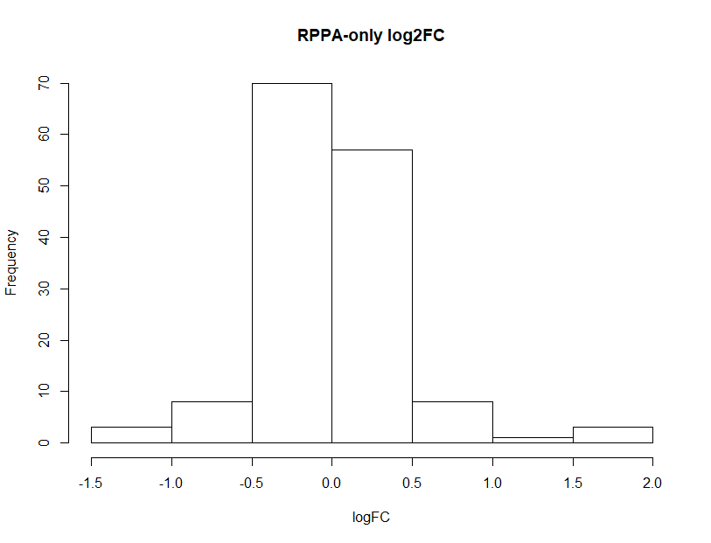
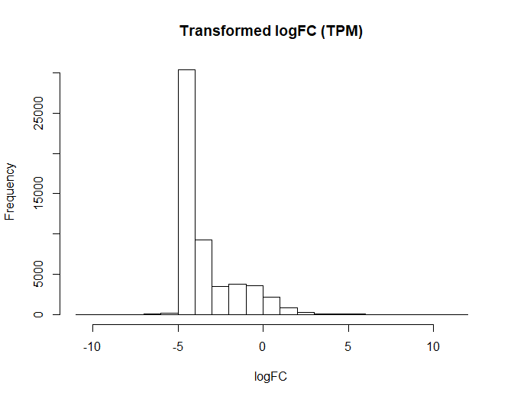
Distribution of log2(FC)
log2(FC) = log2(pos) – log2(neg)

Slide 5
Pathway Analysis
Analysis on RNA-only and integrative (RPKM and TPM) fold changes
Functional Enrichment (Have not finished unfortunately)
Database: GO, KEGG, Reactome
Tools: DAVID, clusterProfiler
GSEA
Database: MISGDB (Category 2), GO, KEGG, Reactome
Tools: clusterProfiler

Slide 6
Top Integrative vs. RNA-only Pathways Take top integrative pathways (RPKM and TPM) and compare with RNA-only pathway values

Slide 7
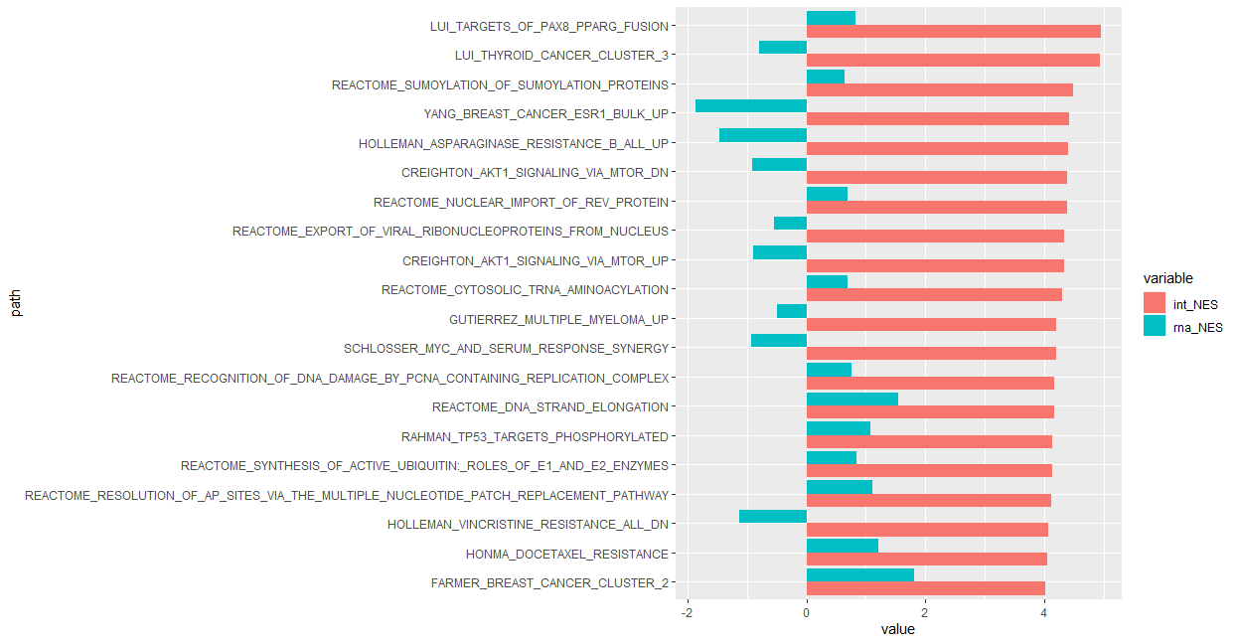
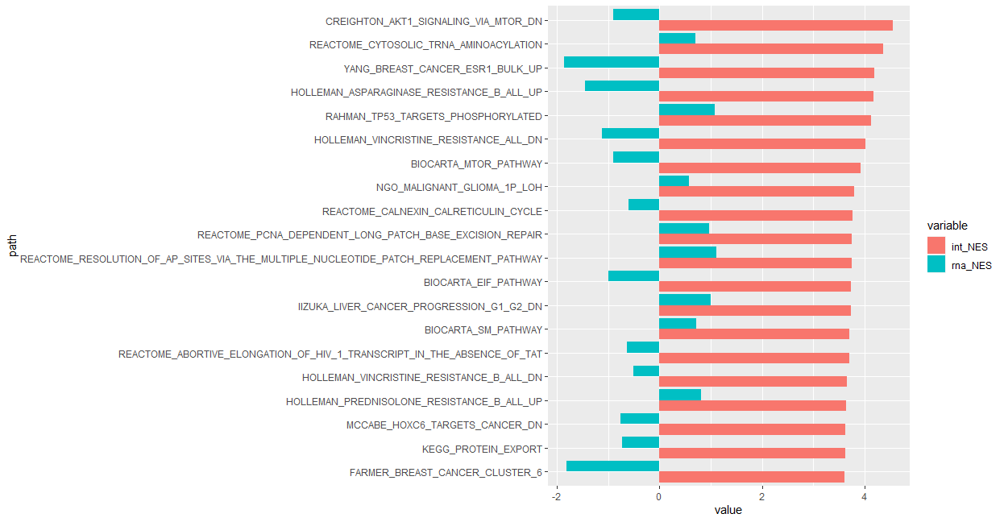
GSEA: MSIGDB Up Pathways
RPKM
TPM
Notes:
Some top pathways could be related to breast cancer
Thyroid cancer, liver cancer?
RPKM and RNA match sometimes, but sometimes go the other way

Slide 8
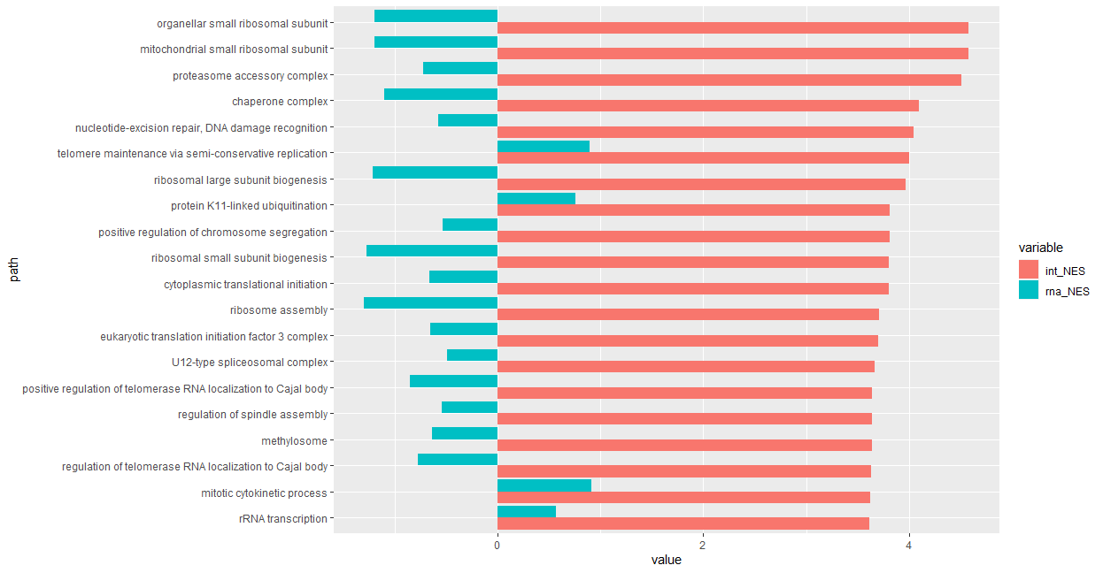
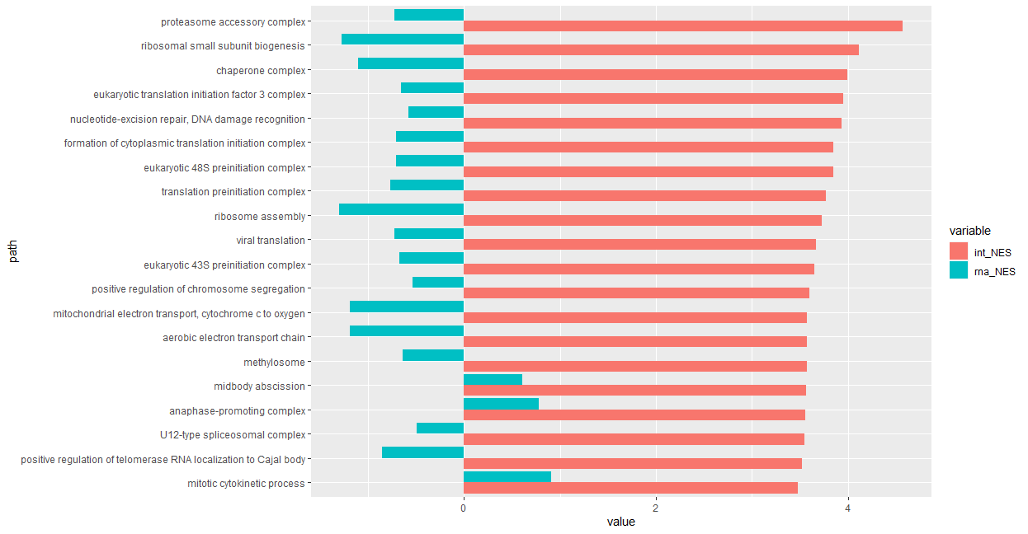
GSEA: GO Up Pathways
RPKM
TPM

Slide 9
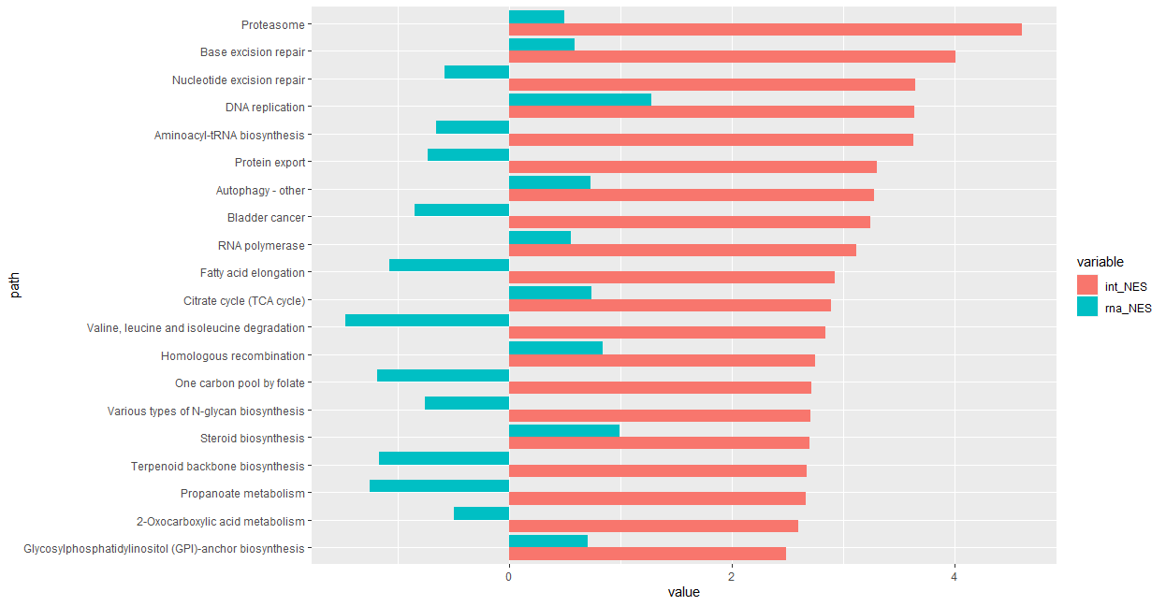
GSEA: KEGG Up Pathways
RPKM
TPM
No pathways

Slide 10
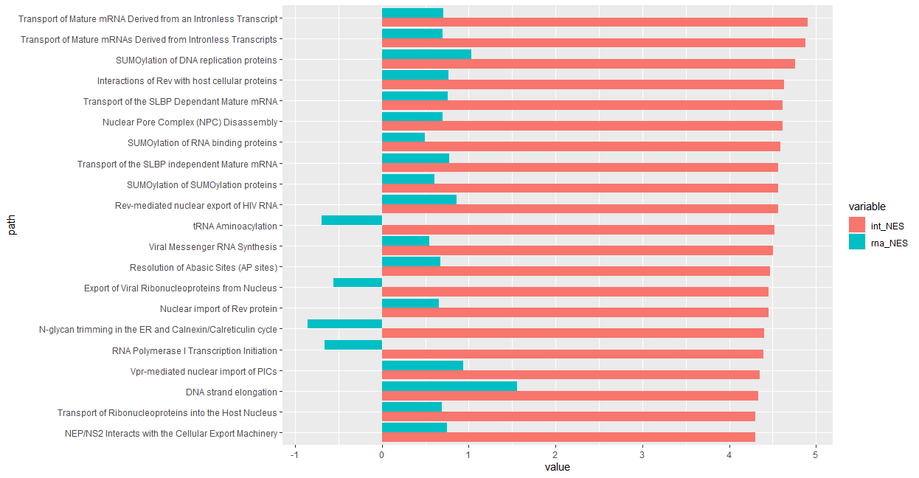
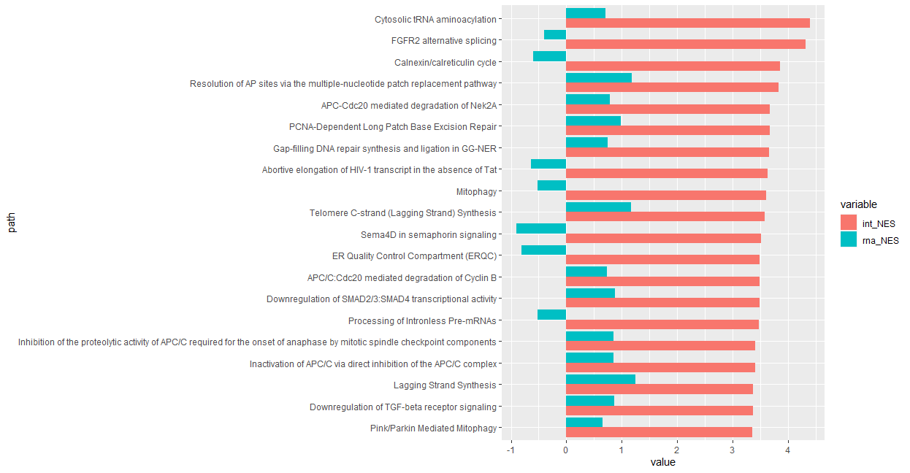
GSEA: Reactome Up Pathways
RPKM
TPM

Slide 11
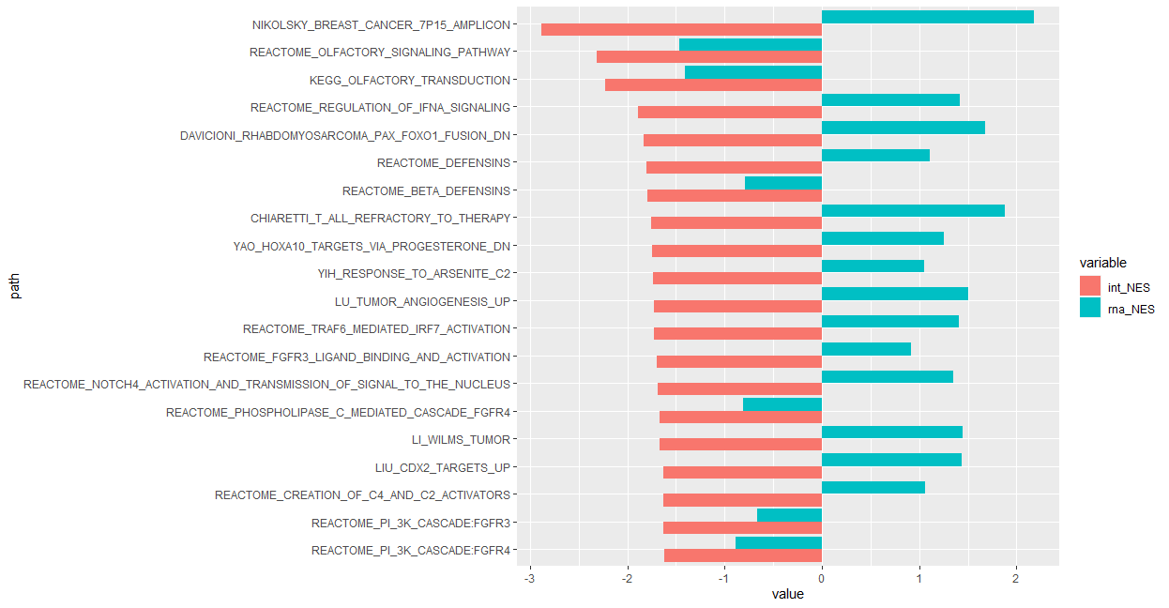
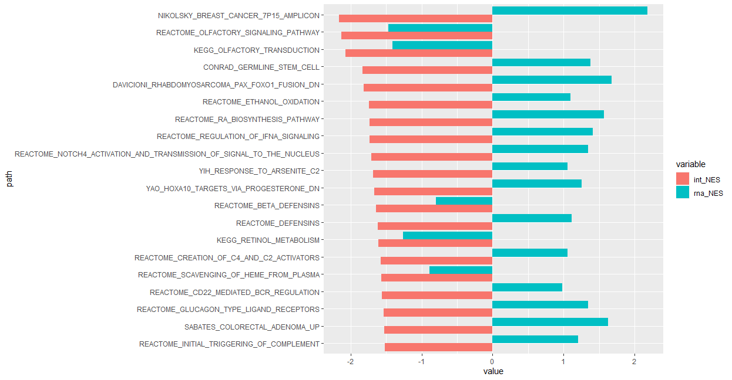
GSEA: MSIGDB Down Pathways
RPKM
TPM

Slide 12
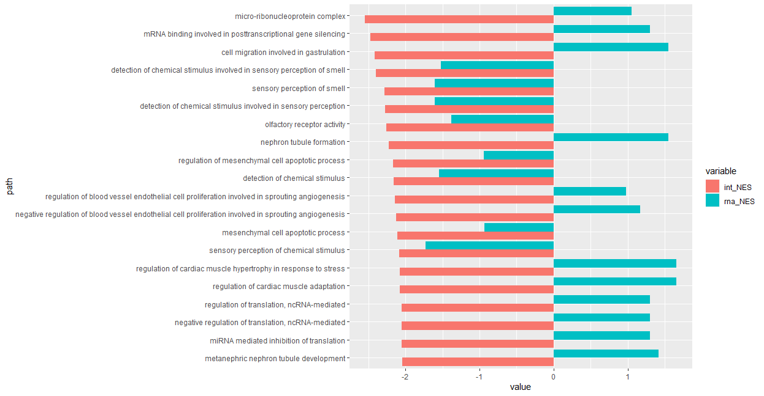
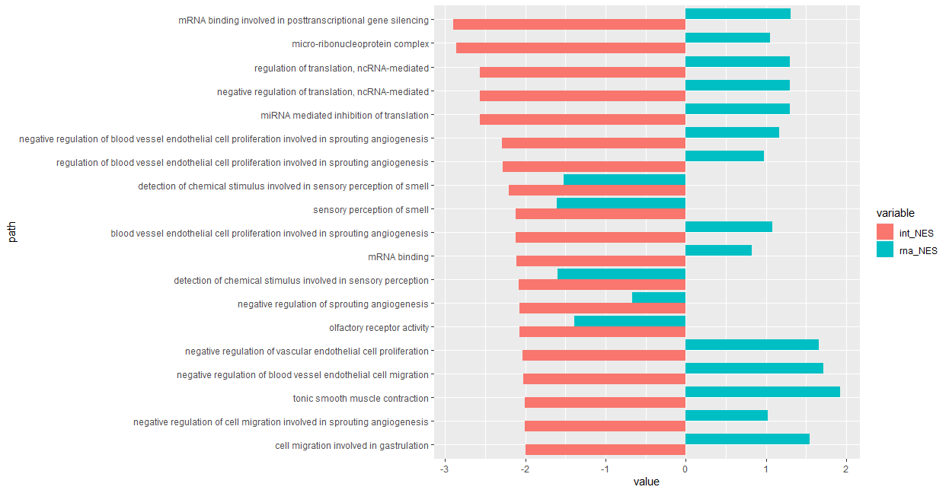
GSEA: GO Down Pathways
RPKM
TPM

Slide 13
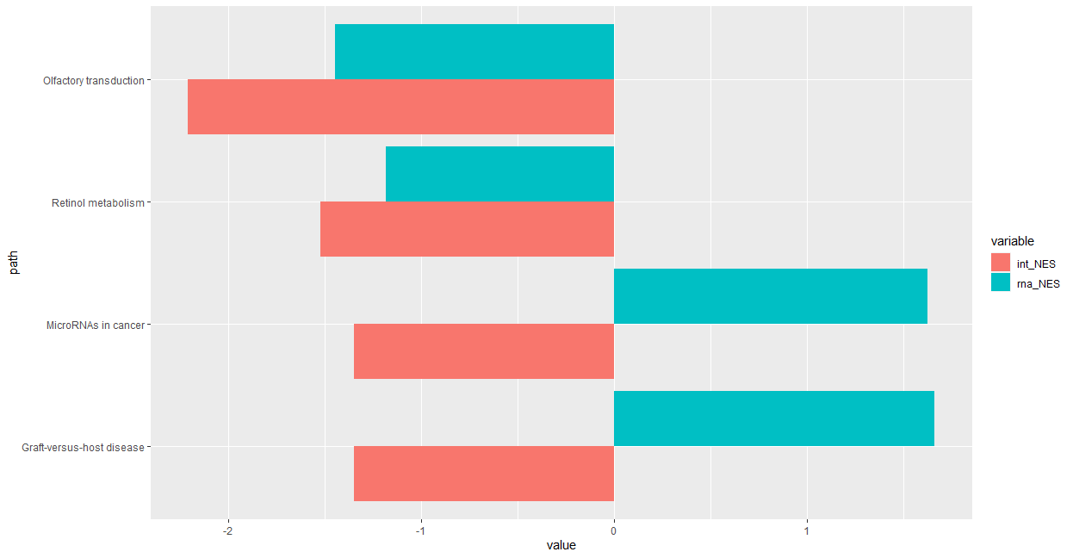
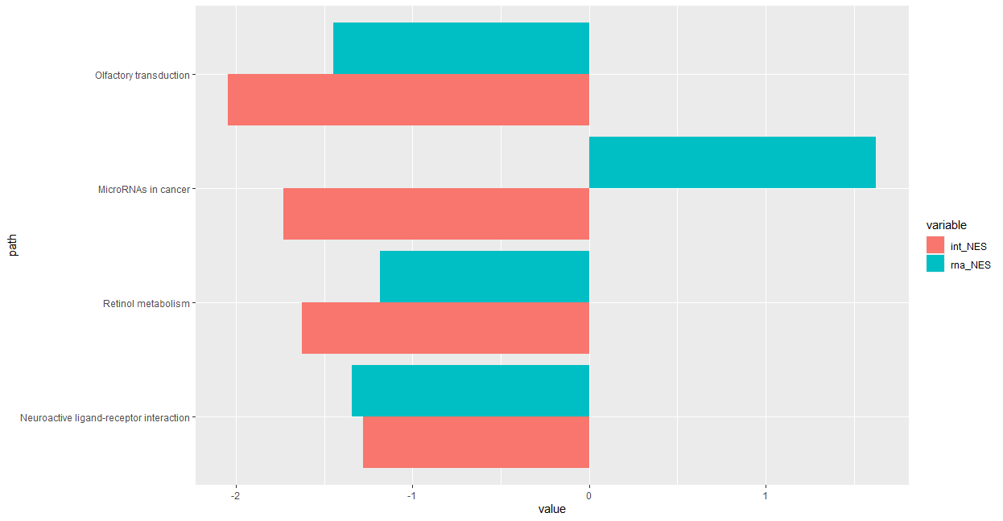
GSEA: KEGG Down Pathways
RPKM
TPM

Slide 14
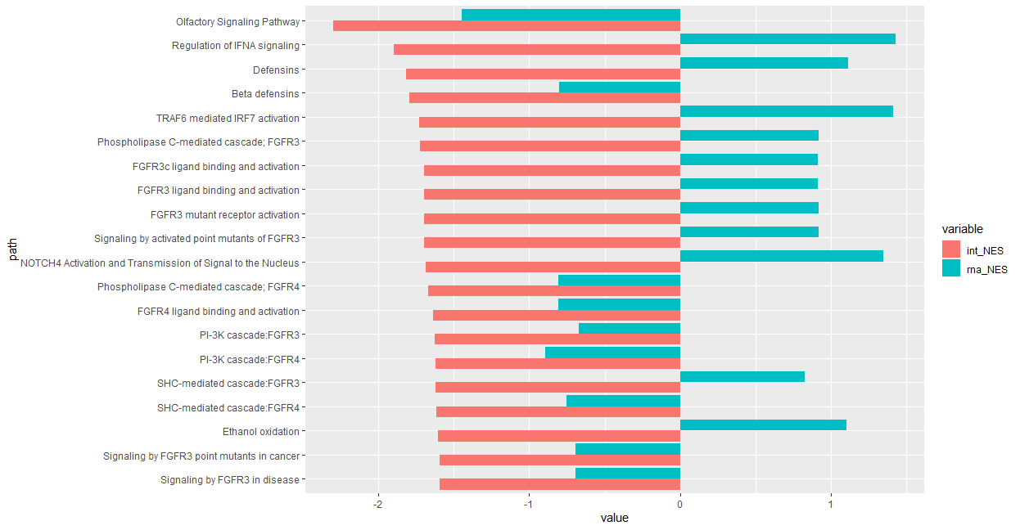
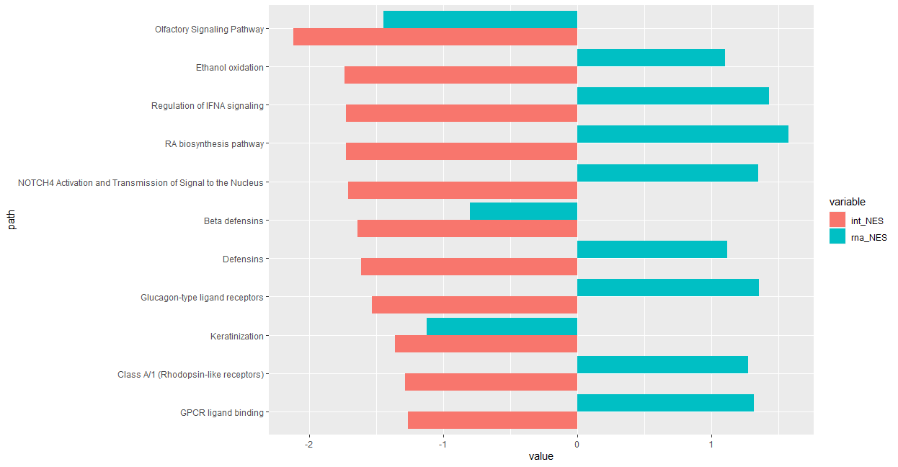
GSEA: Reactome Down Pathways
RPKM
TPM

Slide 15
Top RNA-only vs. Integrative Pathways Take top RNA-only and compare with integrative pathways (RPKM and TPM) pathway values

Slide 16
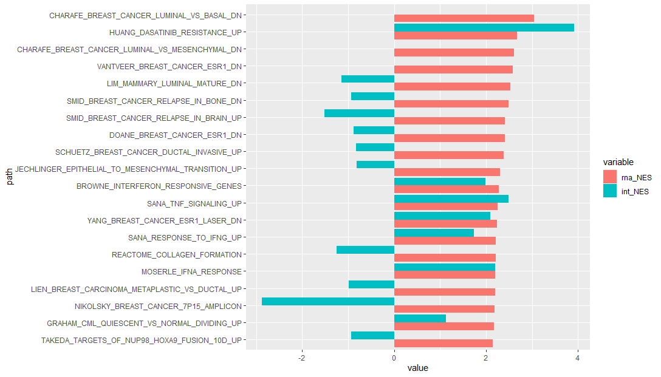
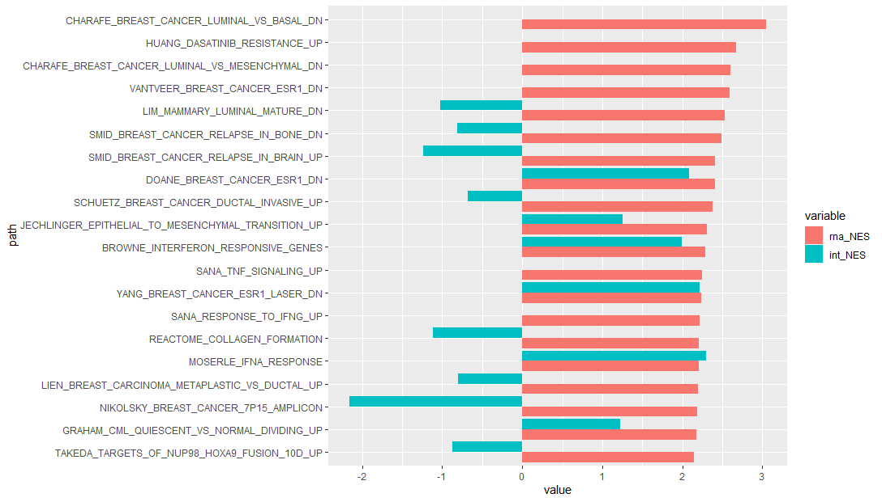
GSEA: MSIGDB Up Pathways
RPKM
TPM

Slide 17
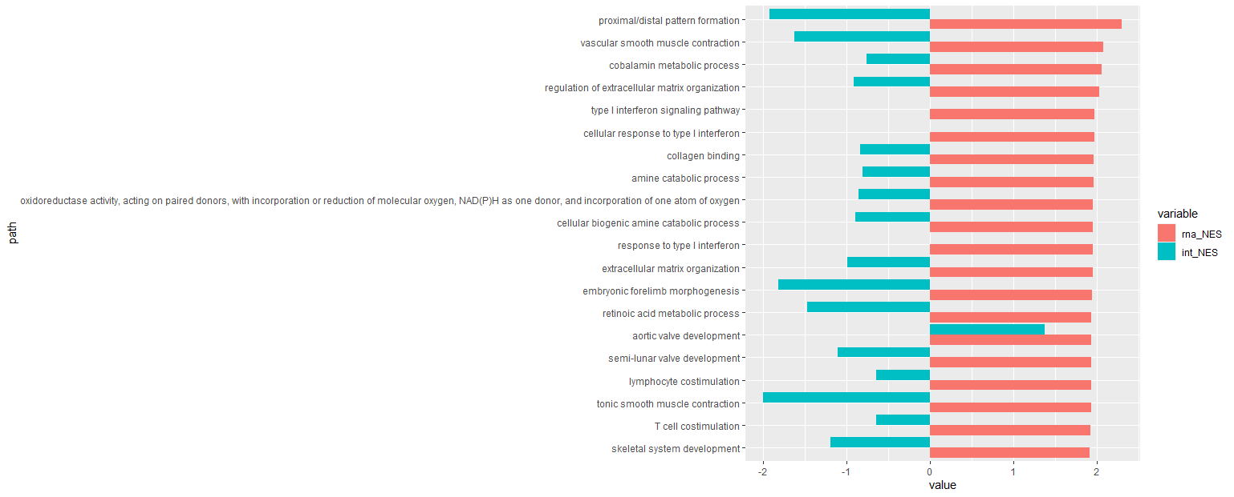
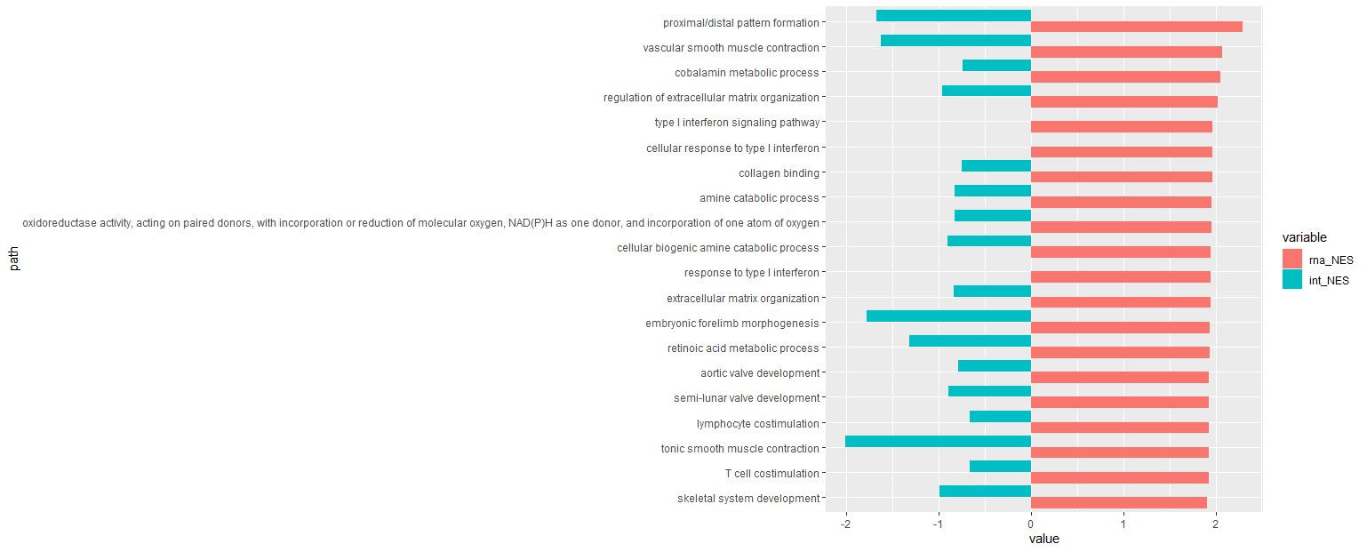
GSEA: GO Up Pathways
RPKM
TPM

Slide 18
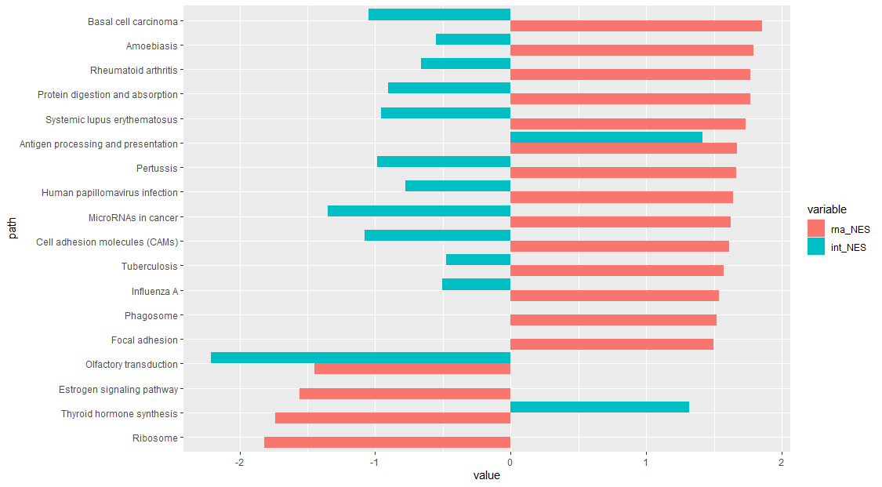
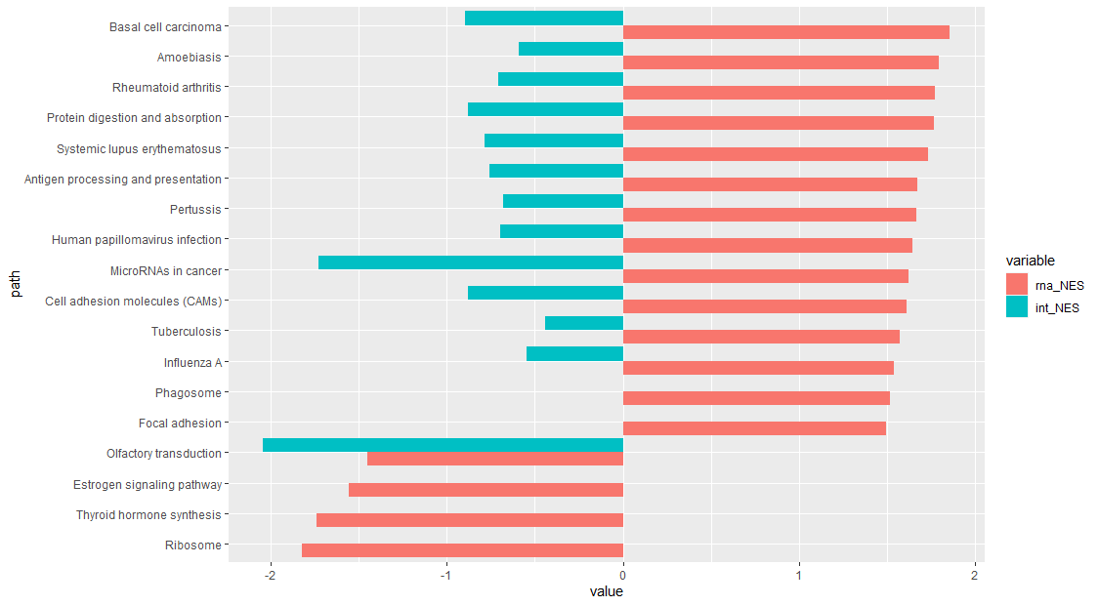
GSEA: KEGG Up Pathways
RPKM
TPM

Slide 19
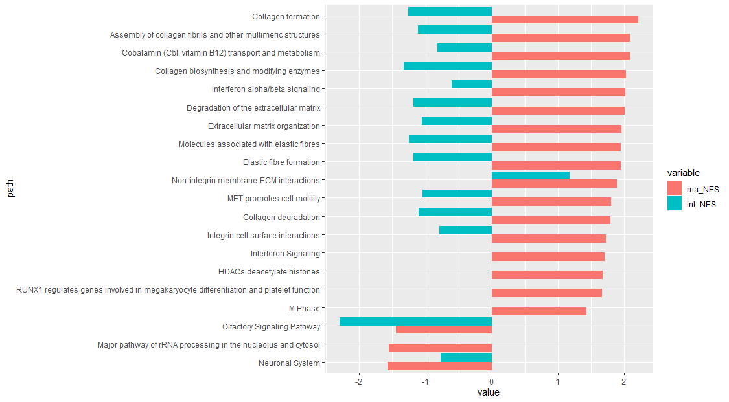

GSEA: Reactome Up Pathways
RPKM
TPM

Slide 20
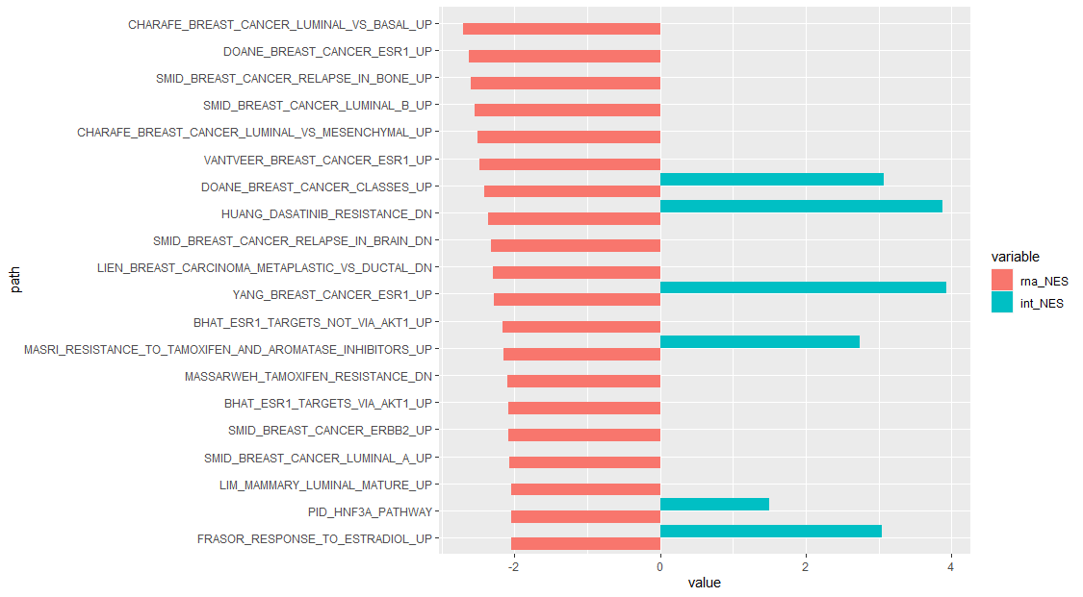
GSEA: MSIGDB Down Pathways
RPKM
TPM

Slide 21
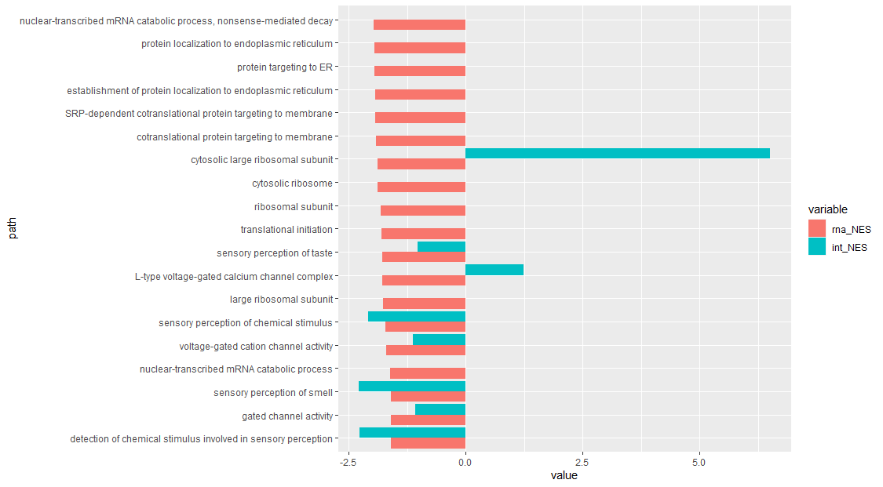
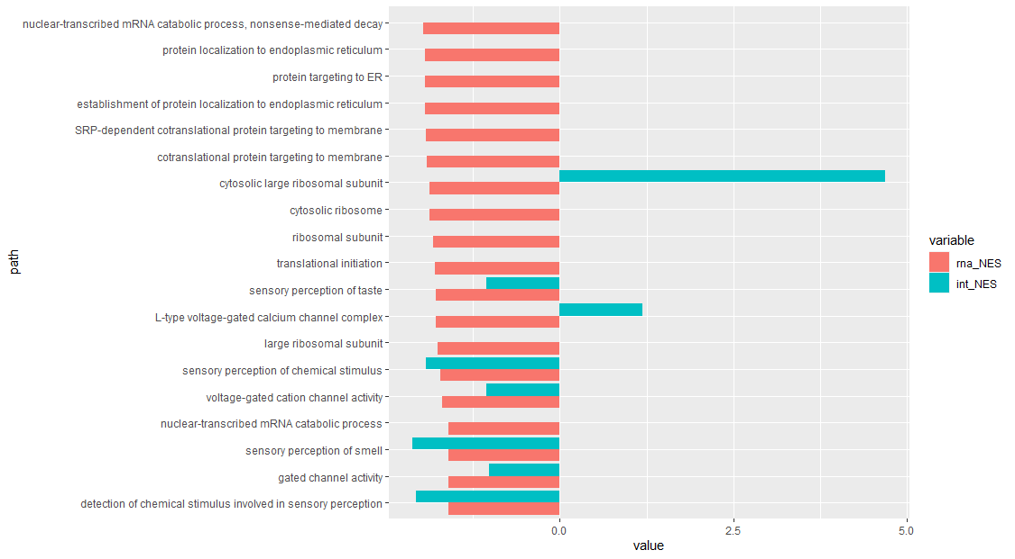
GSEA: GO Down Pathways
RPKM
TPM

Slide 22
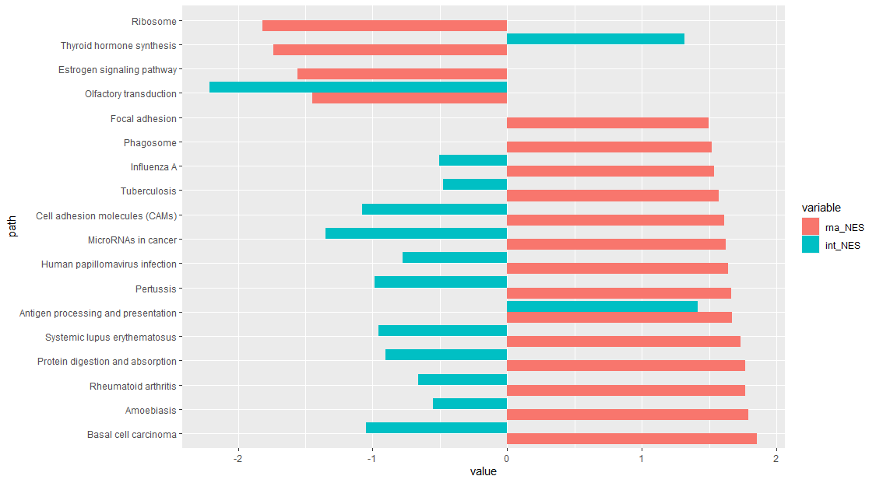
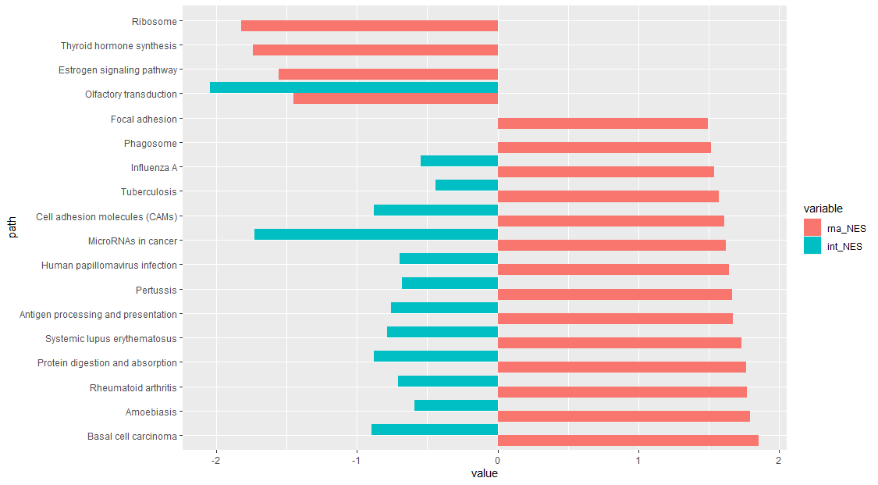
GSEA: KEGG Down Pathways
RPKM
TPM

Slide 23
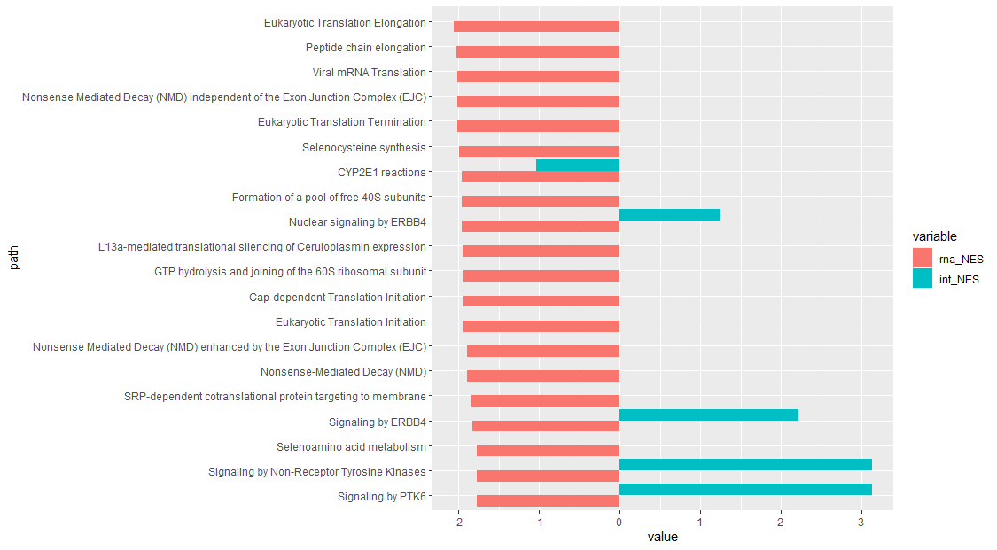

GSEA: Reactome Down Pathways
RPKM
TPM

Slide 24
RNA-only vs. Integrative Common Pathways

Slide 25
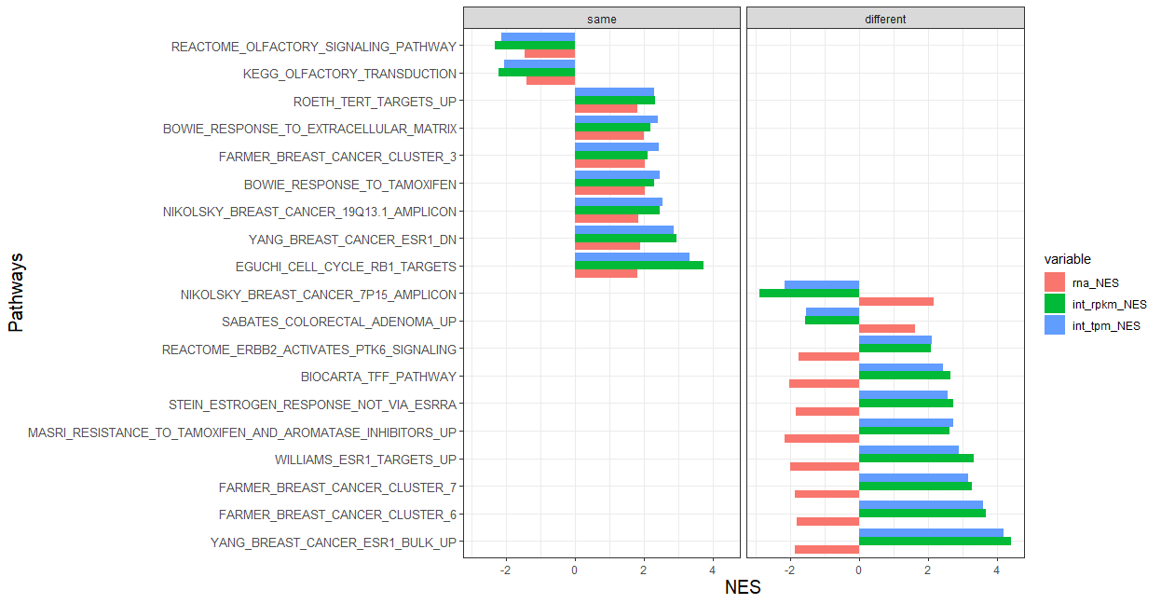
GSEA
Notes:
Pathways that agree in direction
- olfactory

Slide 26
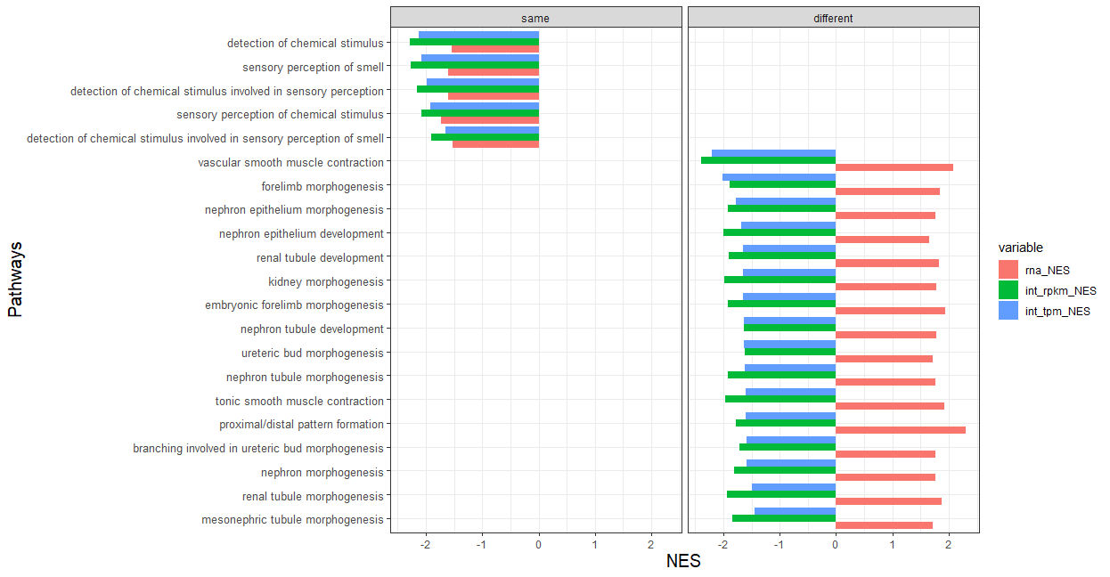
GO

Slide 27
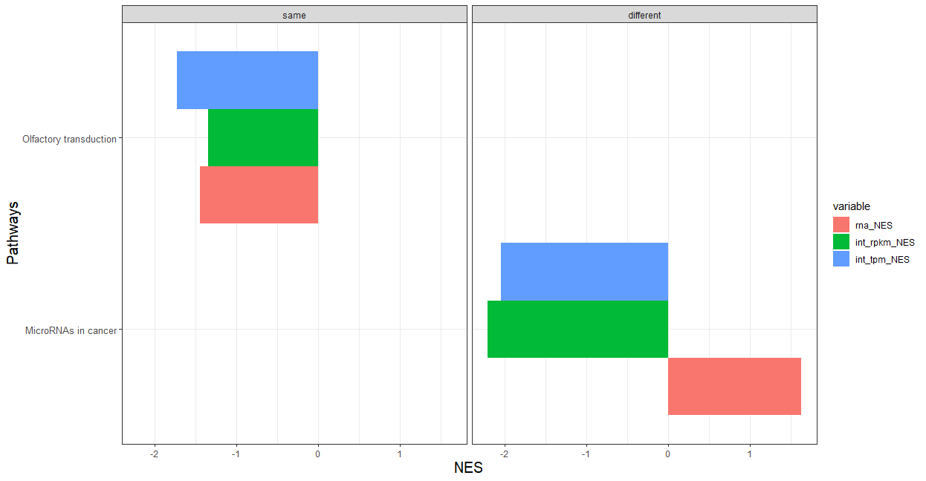
KEGG

Slide 28
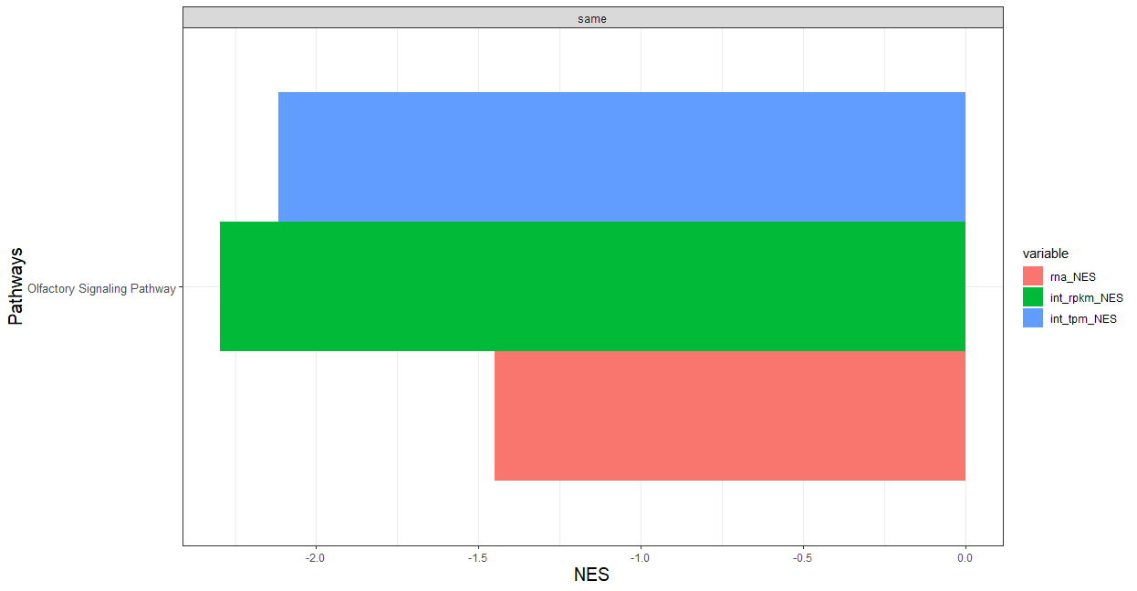
Reactome

Slide 29
Individual Top Pathways

Slide 30
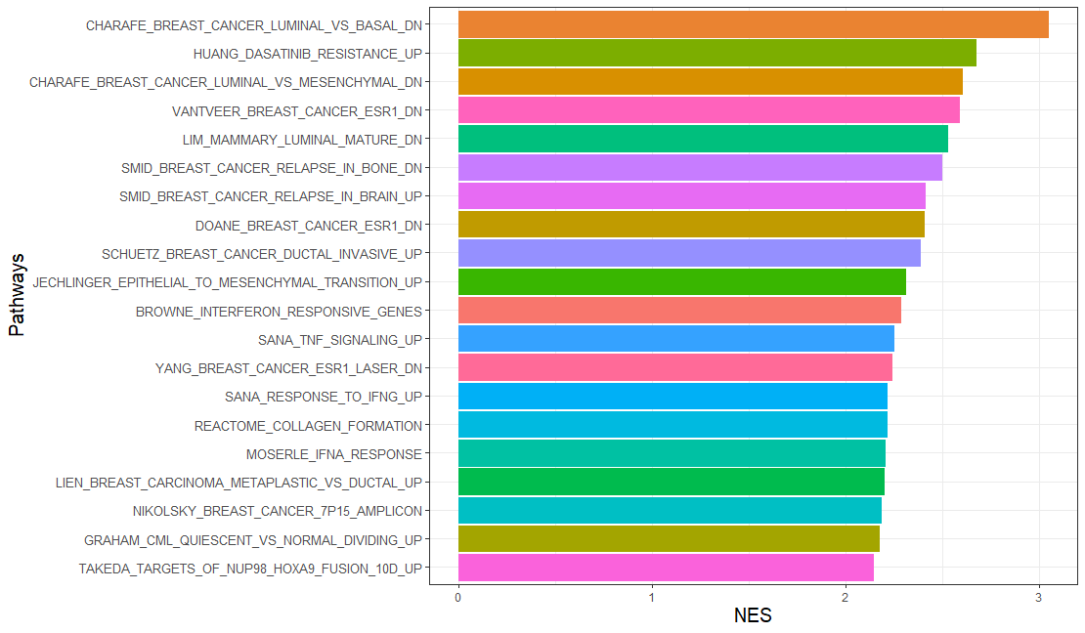
GSEA: Top Up RNA Pathways (MSIGDB)

Slide 31
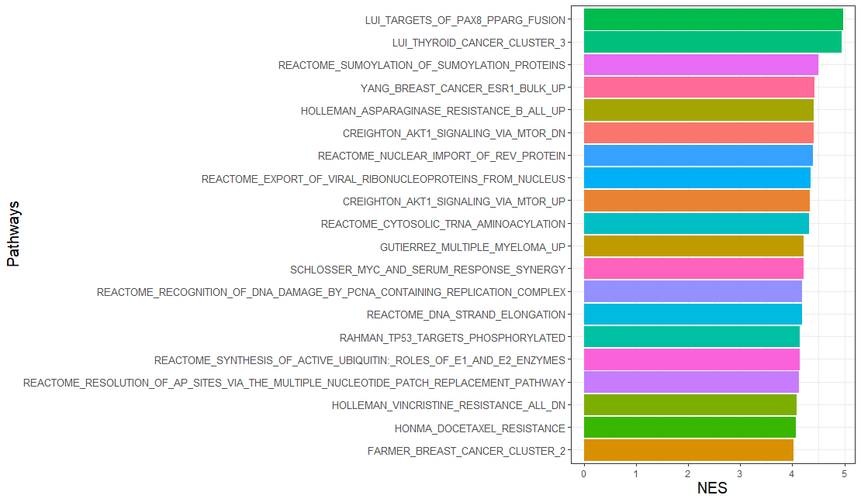
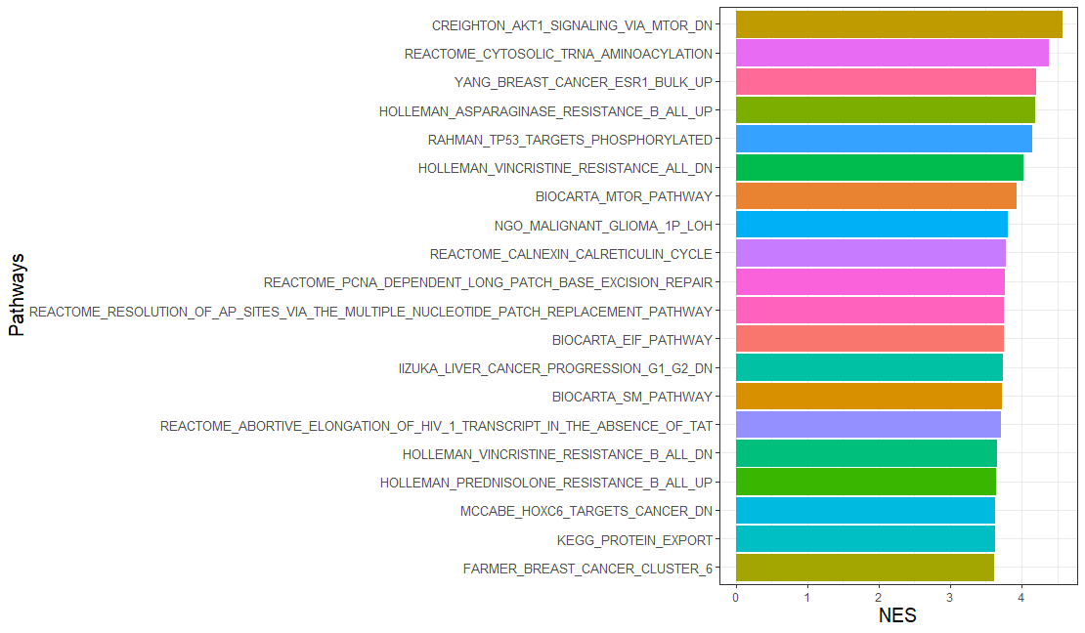
GSEA: Top Up Integrative Pathways (MSIGDB)
RPKM
TPM

Slide 32
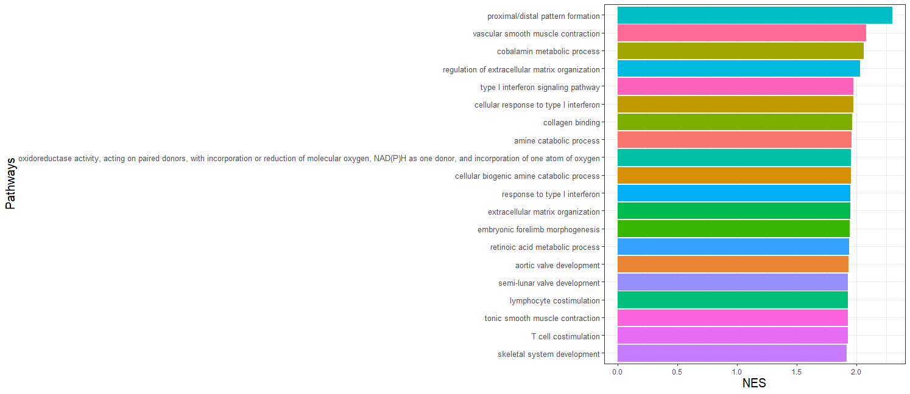
GSEA: Top Up RNA Pathways (GO)

Slide 33
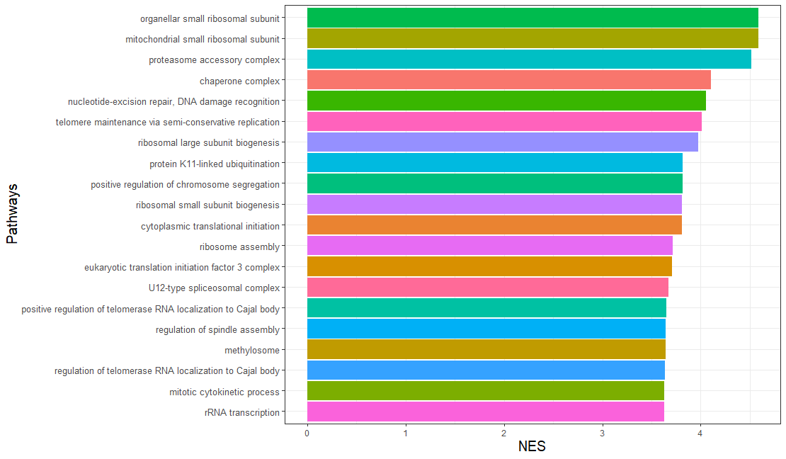
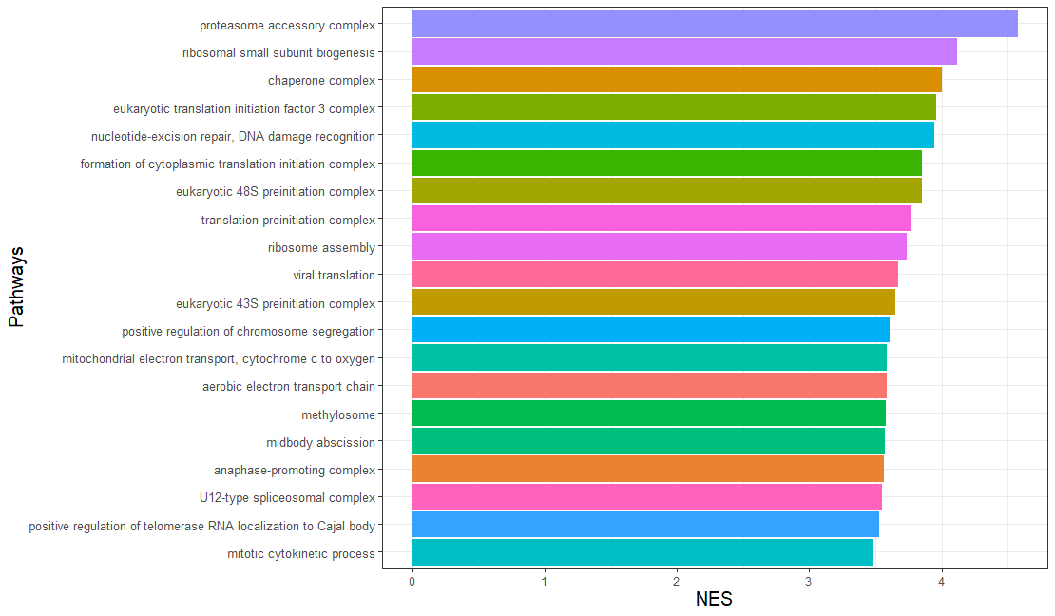
GSEA: Top Up Integrative Pathways (GO)
RPKM
TPM

Slide 34
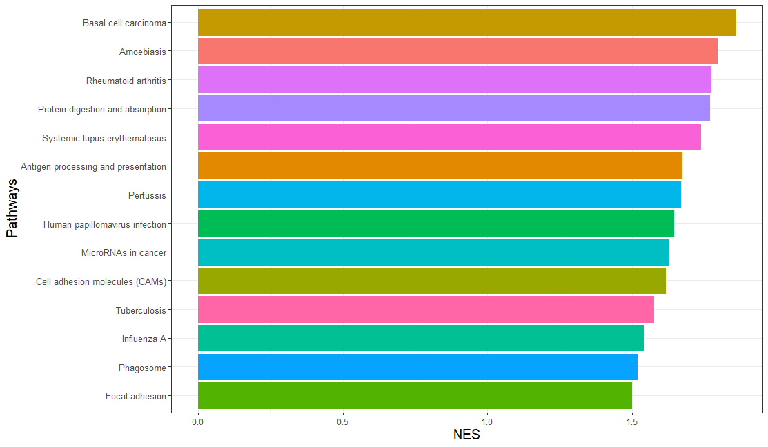
GSEA: Top Up RNA Pathways (KEGG)

Slide 35
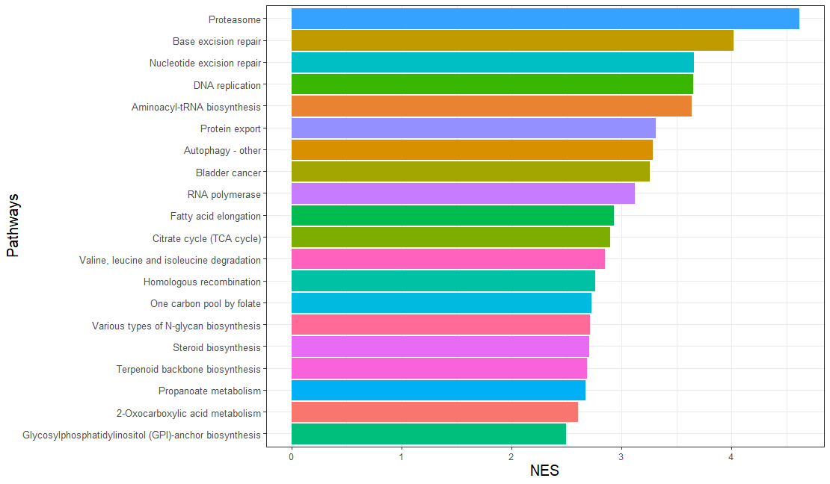
GSEA: Top Up Integrative Pathways (KEGG)
RPKM
TPM
No pathways

Slide 36
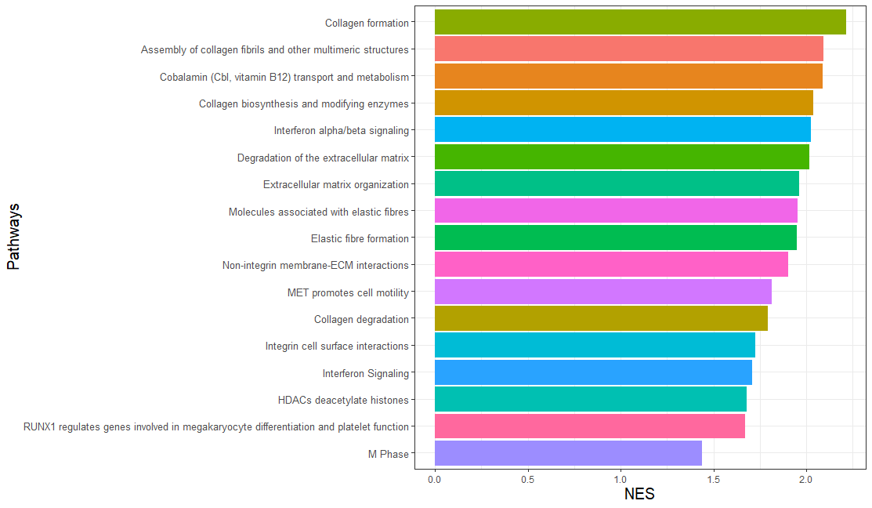
GSEA: Top Up RNA Pathways (Reactome)

Slide 37
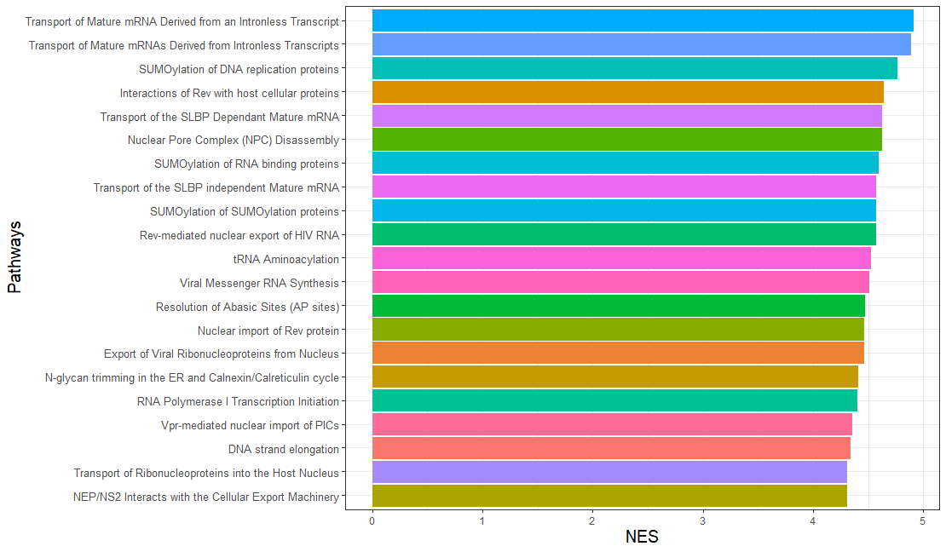
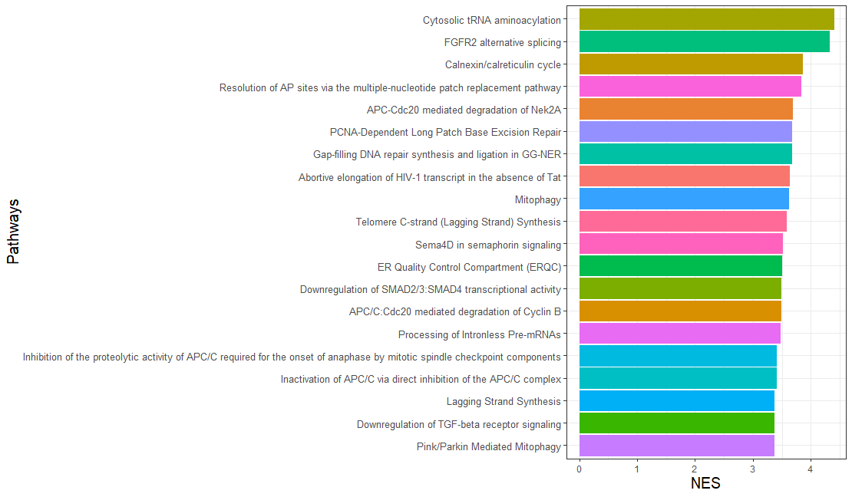
GSEA: Top Up Integrative Pathways (Reactome)
RPKM
TPM

Slide 38
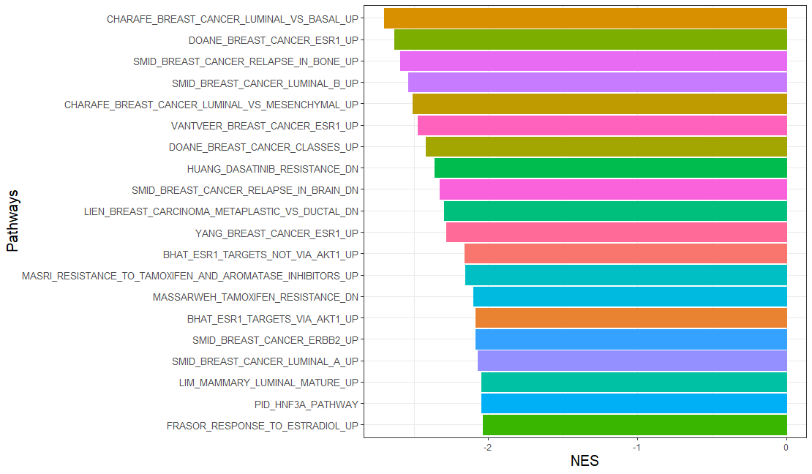
GSEA: Top Down RNA Pathways (MSIGDB)

Slide 39
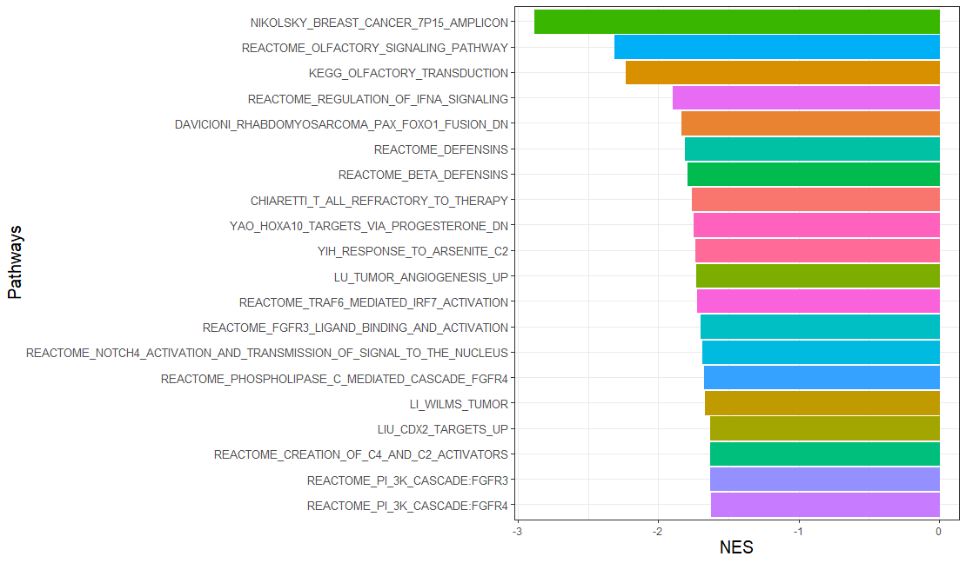

GSEA: Top Down Integrative Pathways (MSIGDB)
RPKM
TPM

Slide 40

GSEA: Top Down RNA Pathways (GO)

Slide 41


GSEA: Top Down Integrative Pathways (GO)
RPKM
TPM

Slide 42

GSEA: Top Down RNA Pathways (KEGG)

Slide 43


GSEA: Top Down Integrative Pathways (KEGG)
RPKM
TPM

Slide 44

GSEA: Top Up RNA Pathways (Reactome)

Slide 45


GSEA: Top Up Integrative Pathways (Reactome)
RPKM
TPM

